Slide 1
HTML Essentials
SGU IT Semester 1 - Web Design Fundamental

Slide 2
HTML Introduction

Slide 3
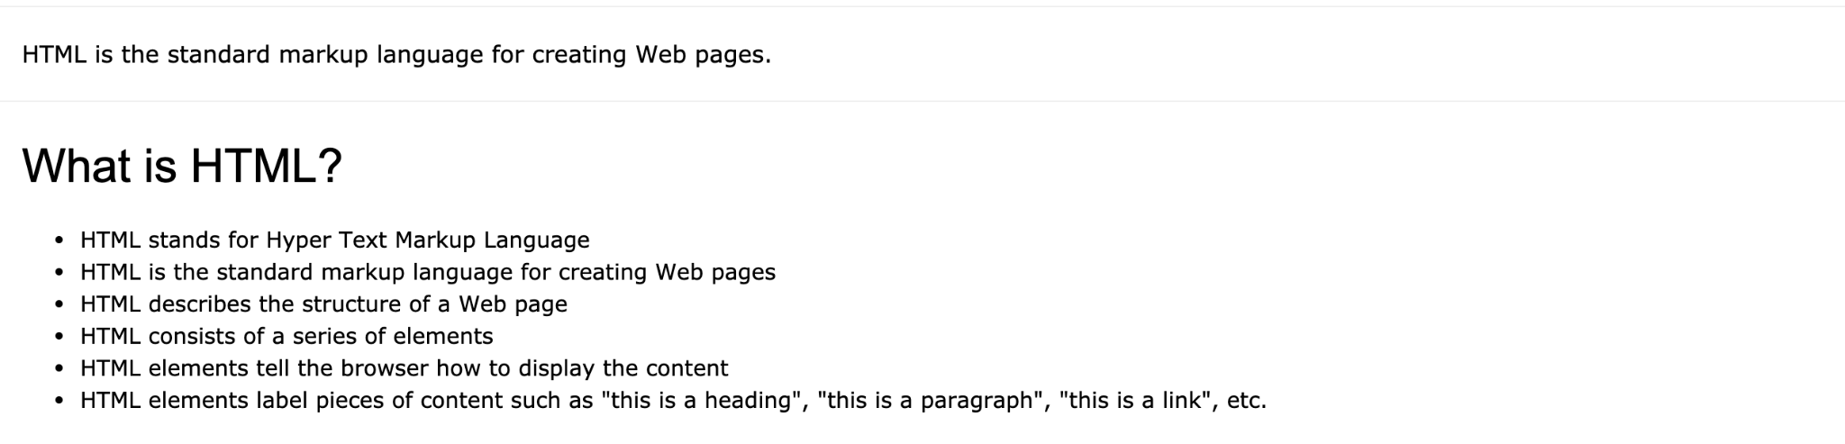
HTML Introduction

Slide 4
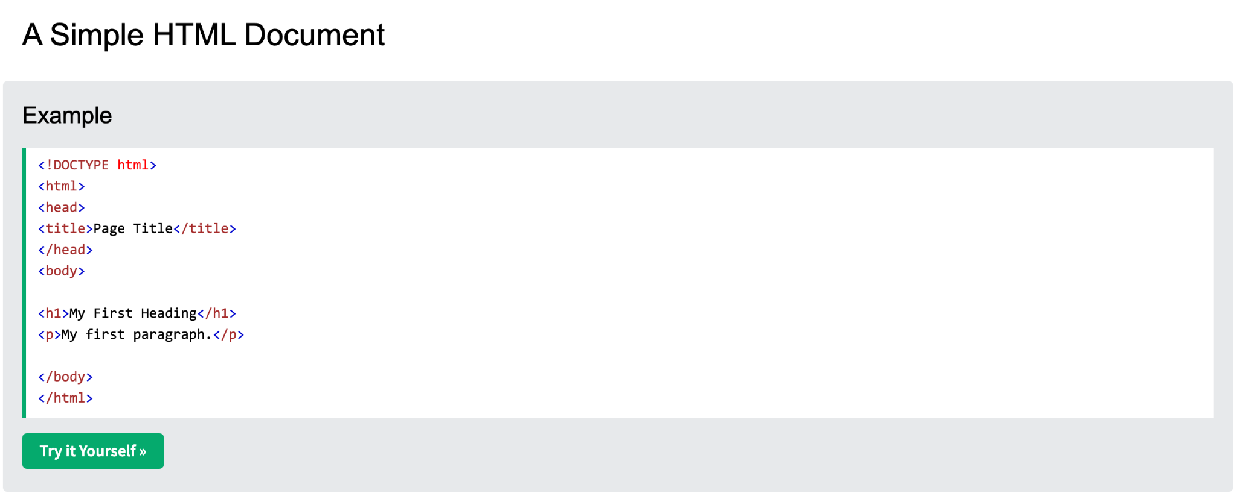
HTML Introduction
The <!DOCTYPE html> declaration defines that this document is an HTML5 document
The <html> element is the root element of an HTML page
The <head> element contains meta information about the HTML page
The <title> element specifies a title for the HTML page (which is shown in the browser's title bar or in the page's tab)
The <body> element defines the document's body, and is a container for all the visible contents, such as headings, paragraphs, images, hyperlinks, tables, lists, etc.
The <h1> element defines a large heading
The <p> element defines a paragraph

Slide 5
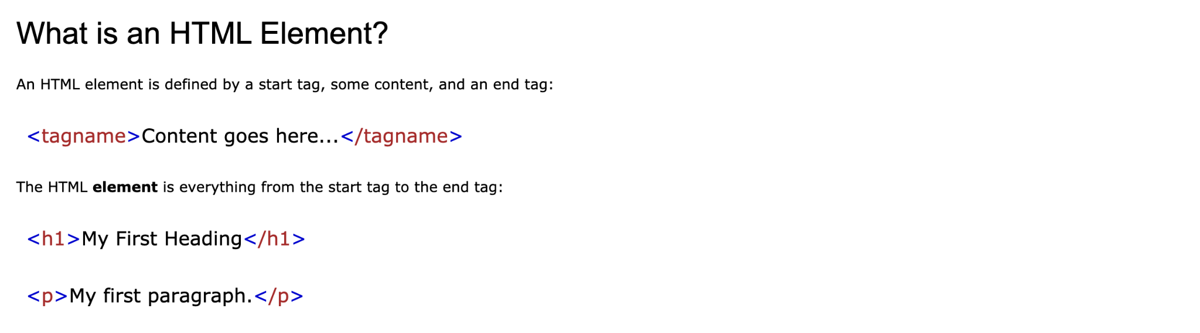
HTML Introduction

Slide 6
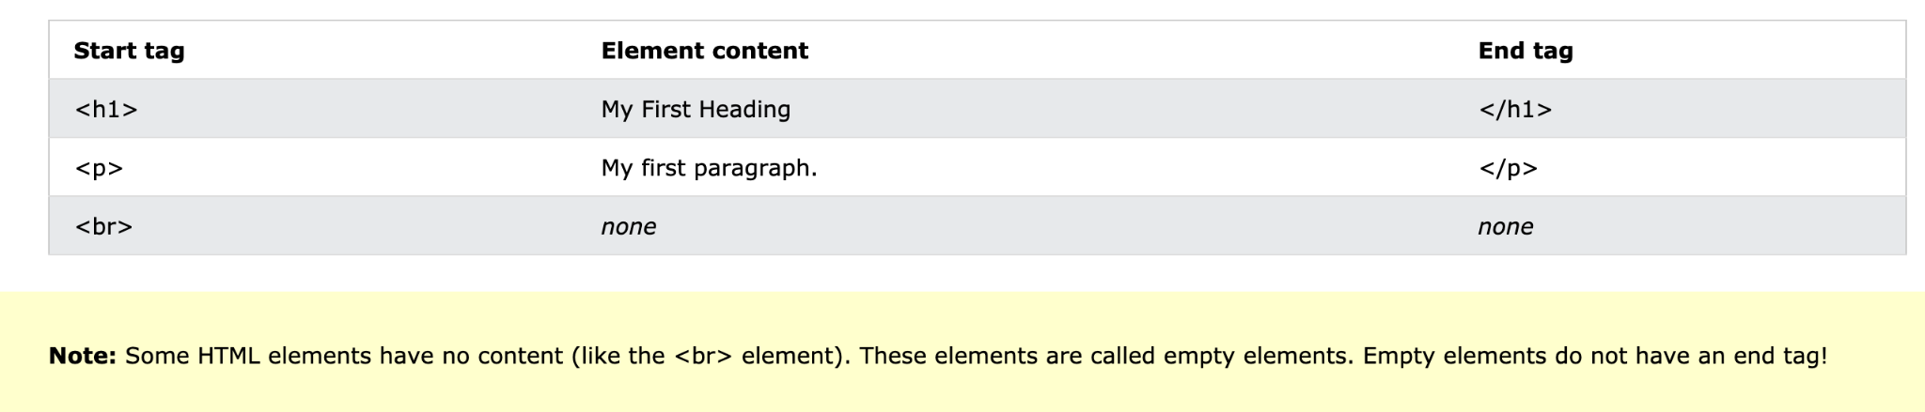
HTML Introduction

Slide 7
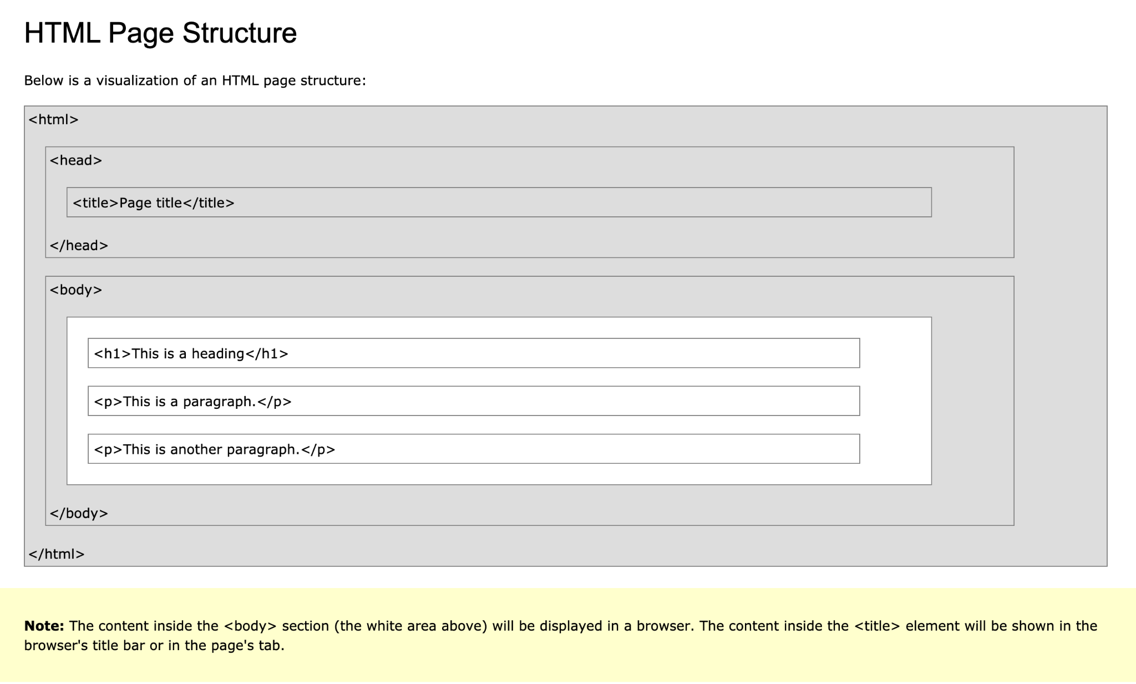

Slide 8
HTML Elements

Slide 9
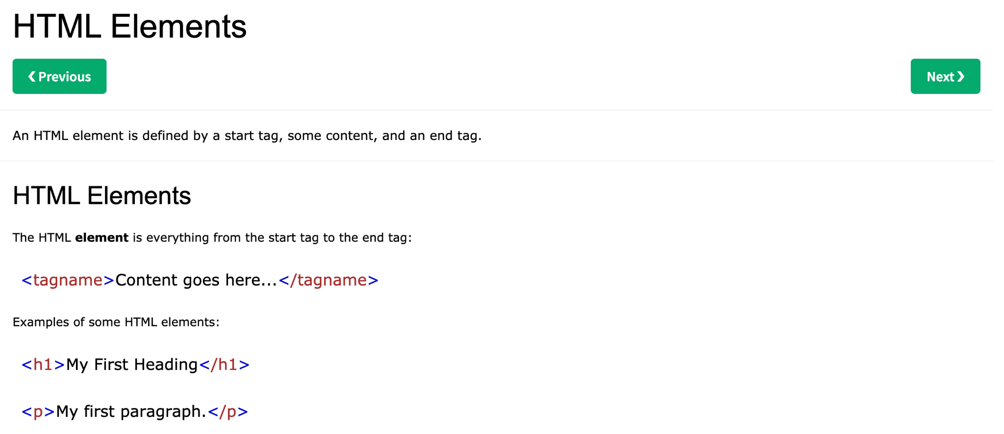
HTML Elements

Slide 10
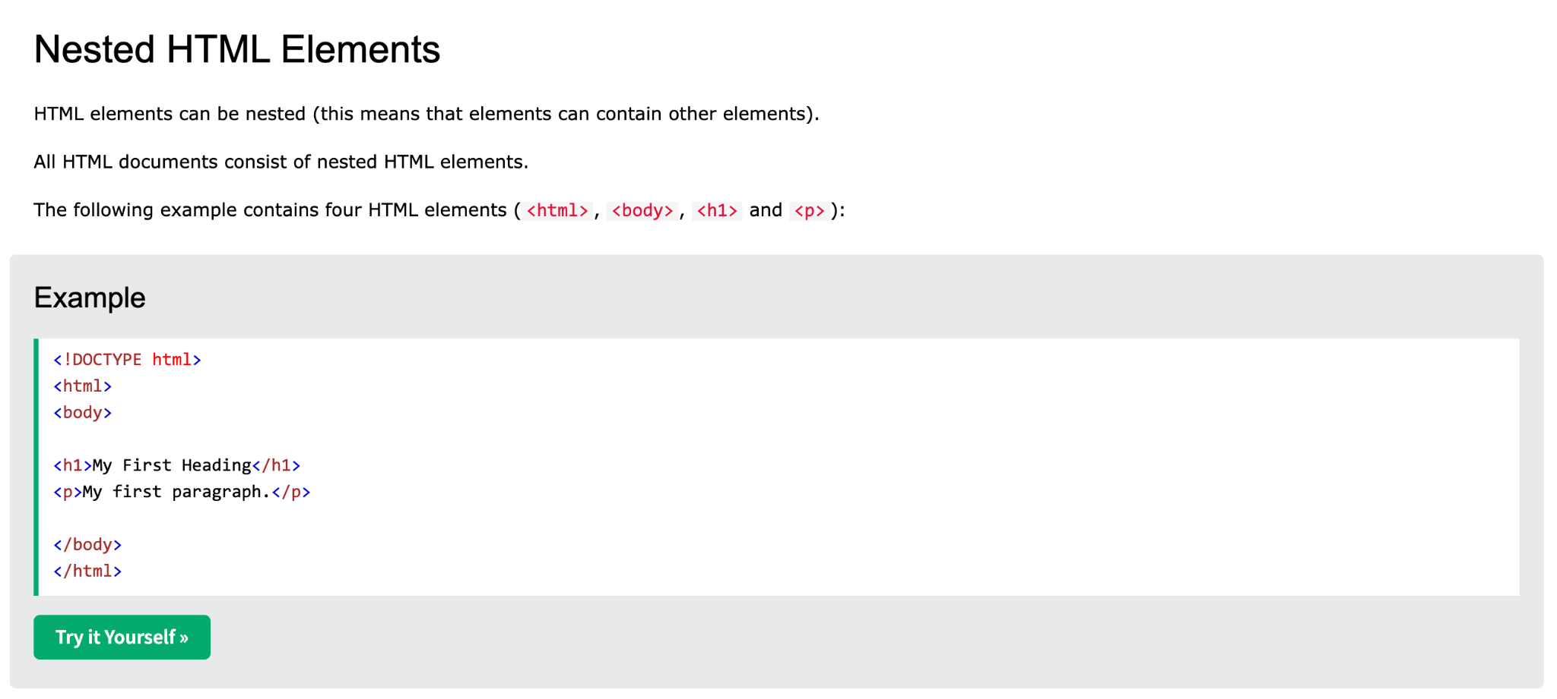
HTML Elements

Slide 11
HTML Attributes

Slide 12
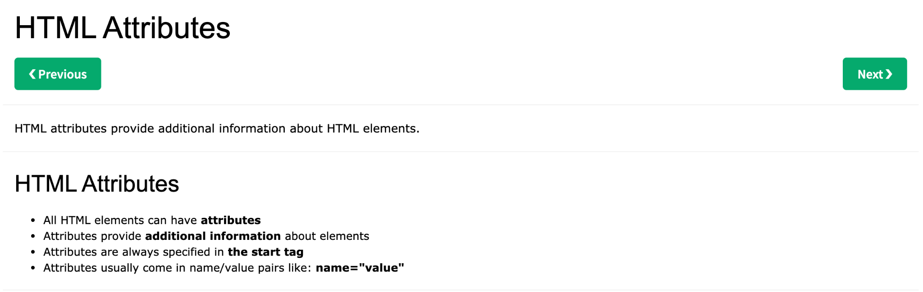
HTML Attributes

Slide 13
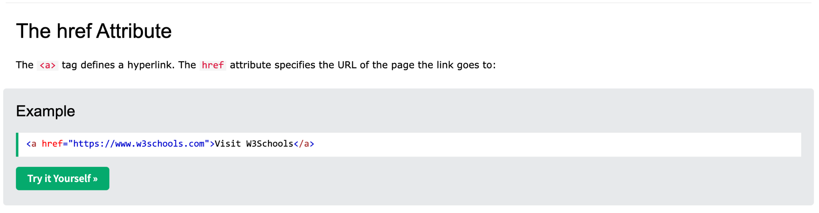
HTML Attributes

Slide 14
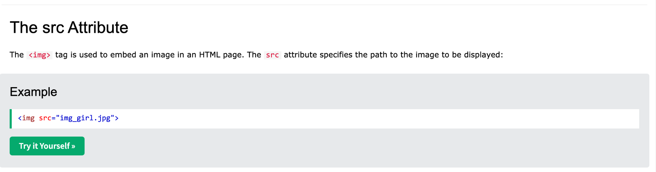
HTML Attributes

Slide 15
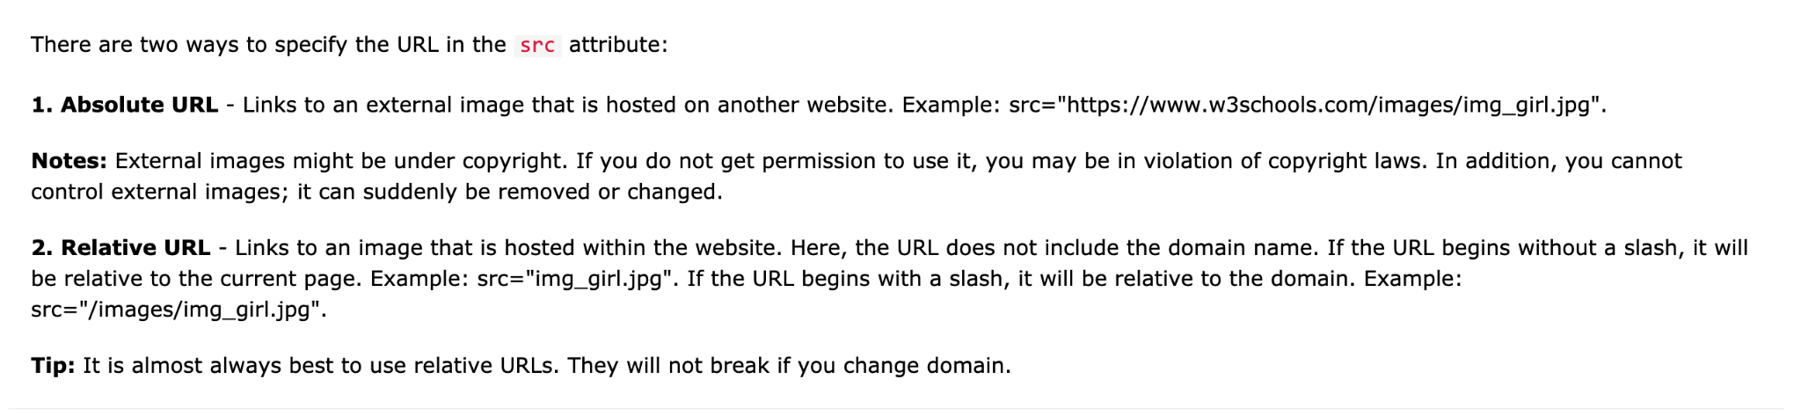
HTML Attributes

Slide 16
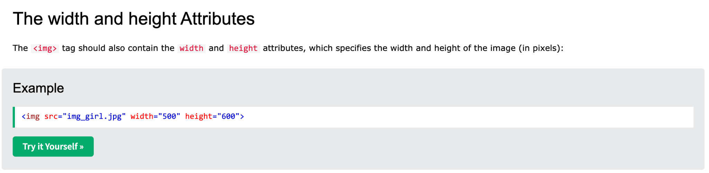
HTML Attributes

Slide 17
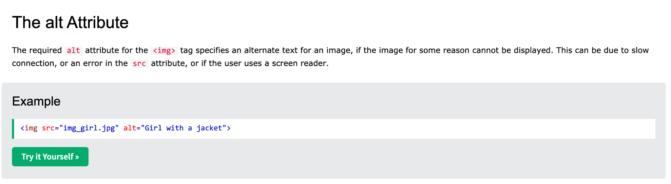
HTML Attributes

Slide 18
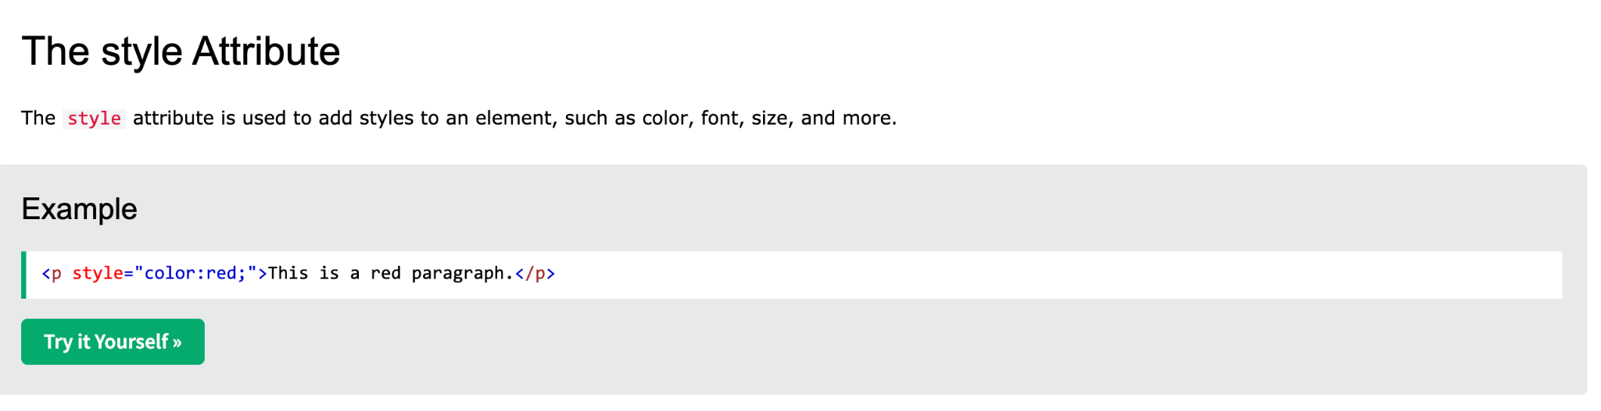
HTML Attributes

Slide 19
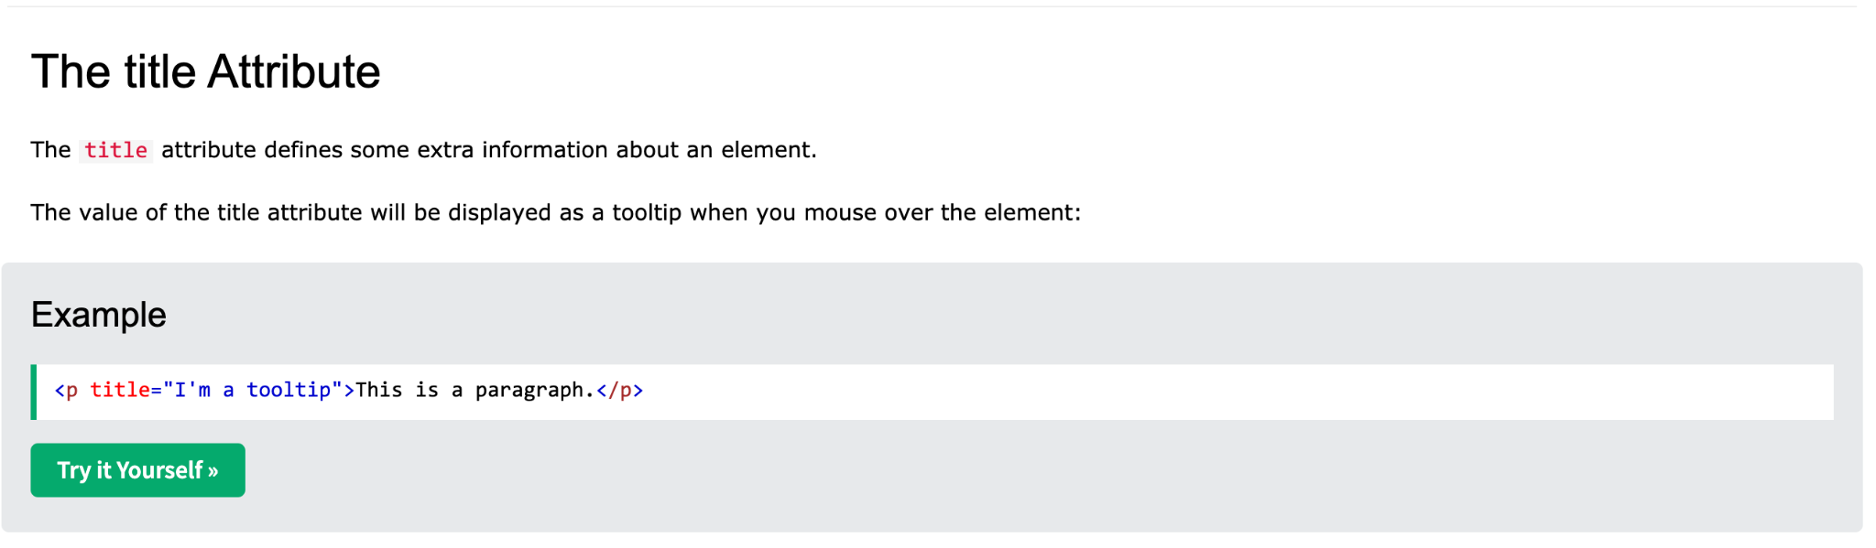
HTML Attributes

Slide 20
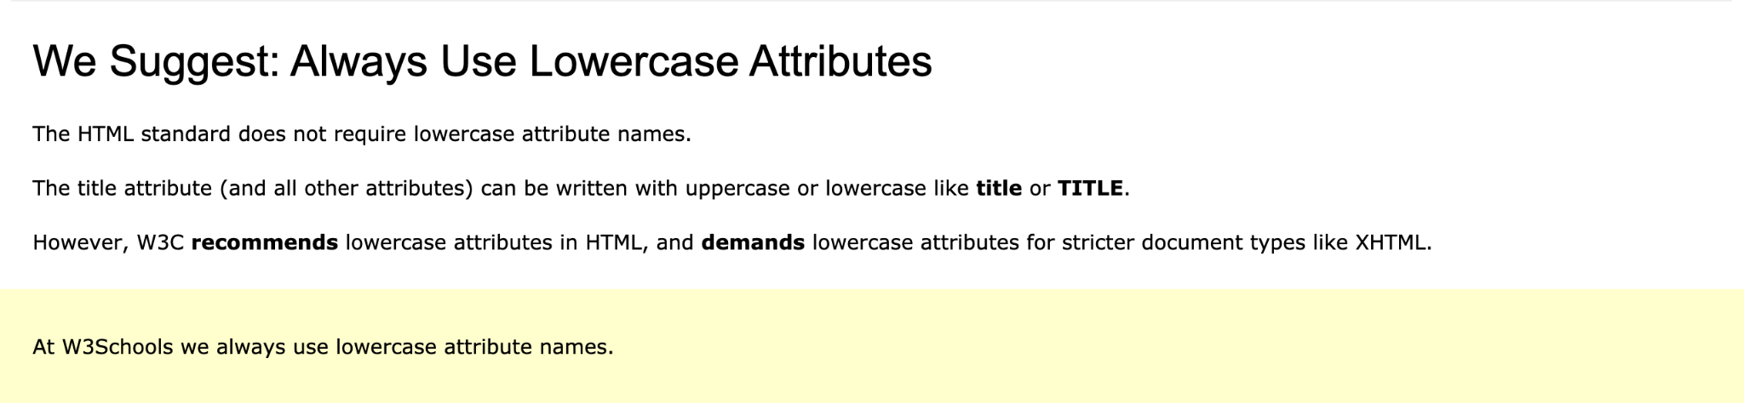
HTML Attributes

Slide 21
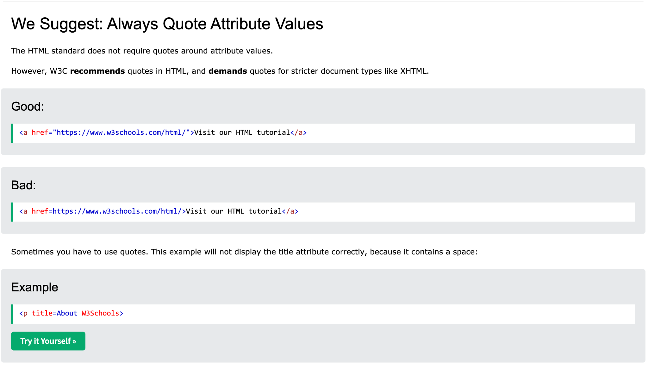
HTML Elements

Slide 22
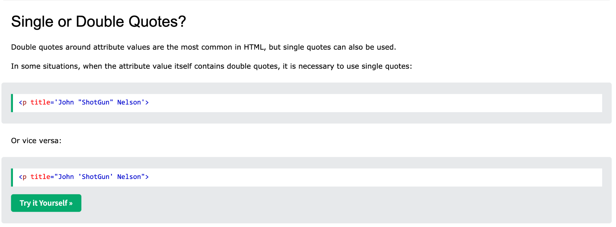
HTML Attributes

Slide 23
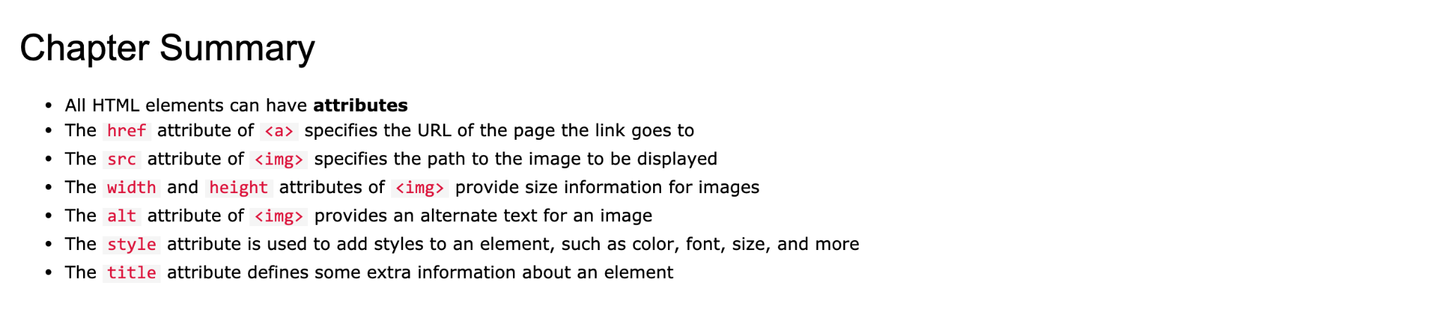
HTML Attributes

Slide 24
HTML Headings

Slide 25
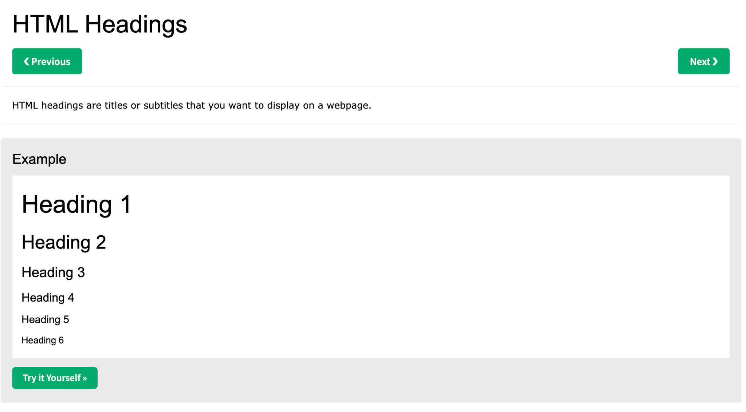
HTML Headings

Slide 26
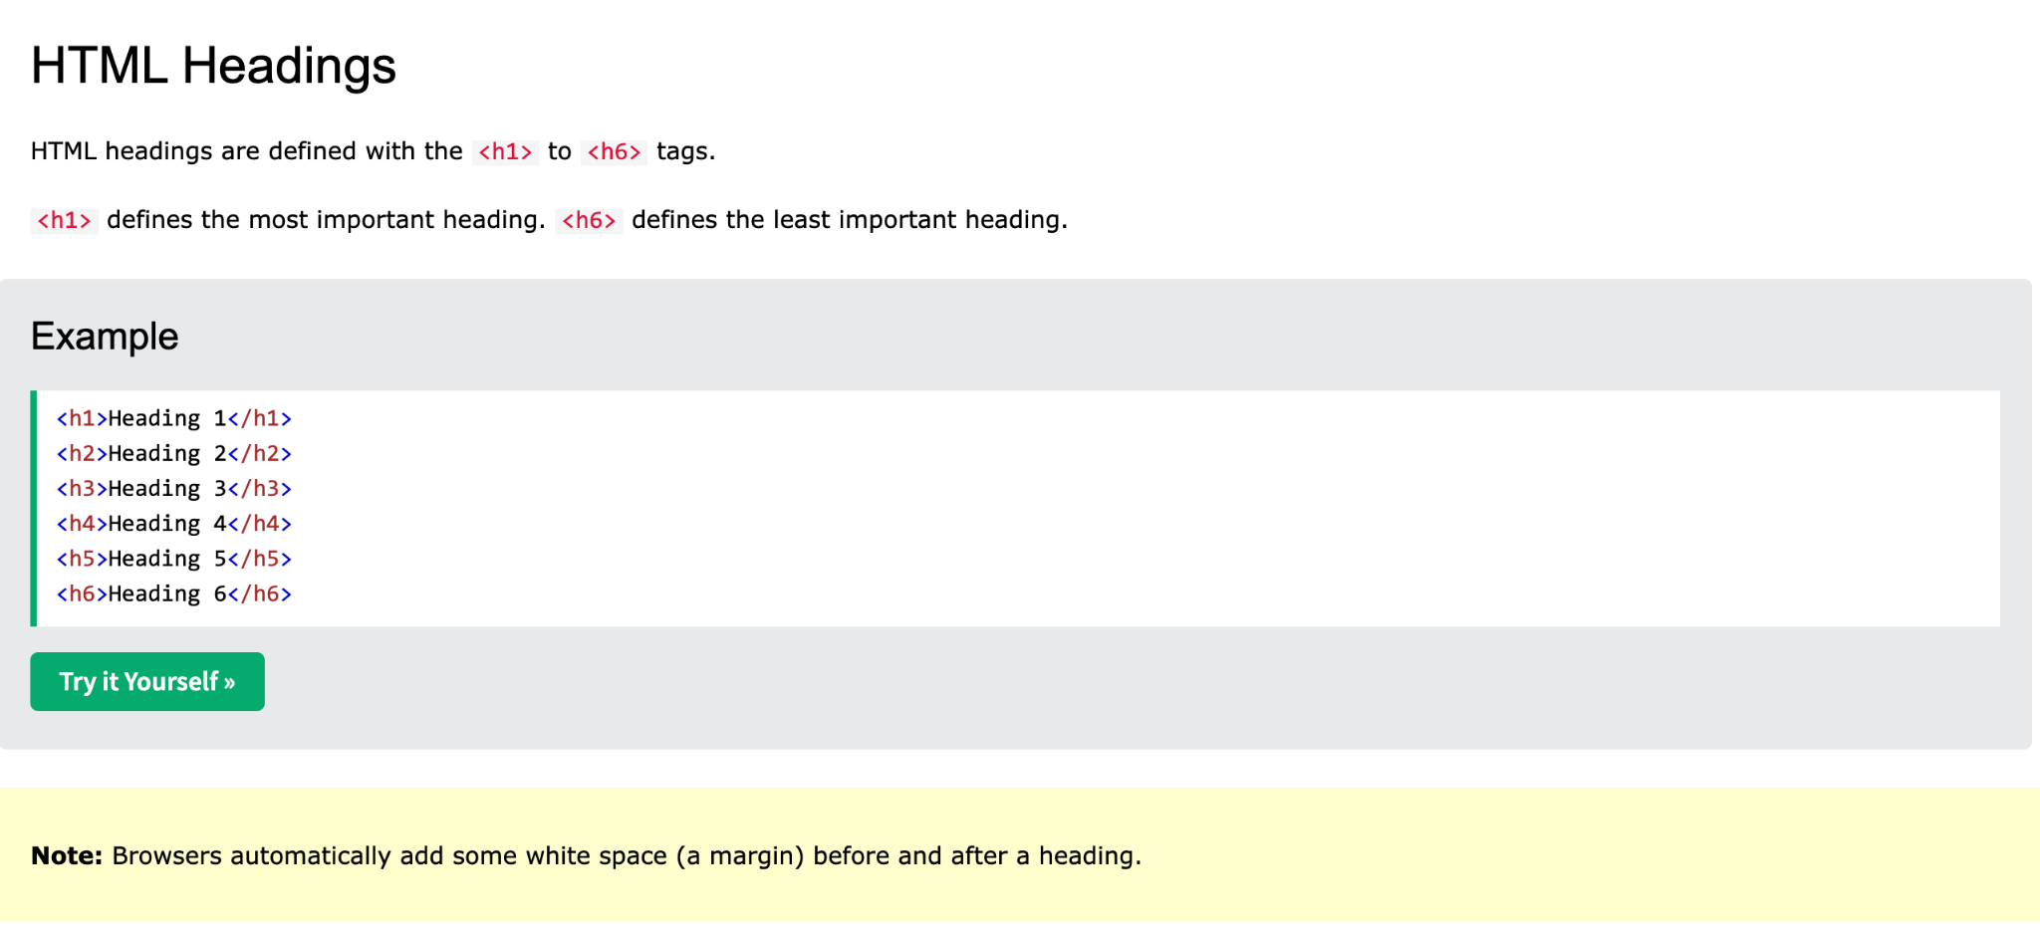
HTML Headings

Slide 27
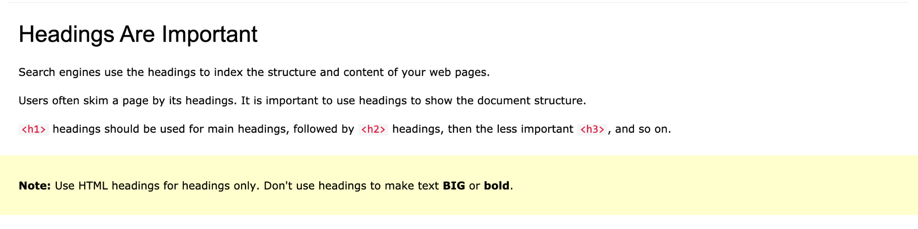
HTML Headings

Slide 28
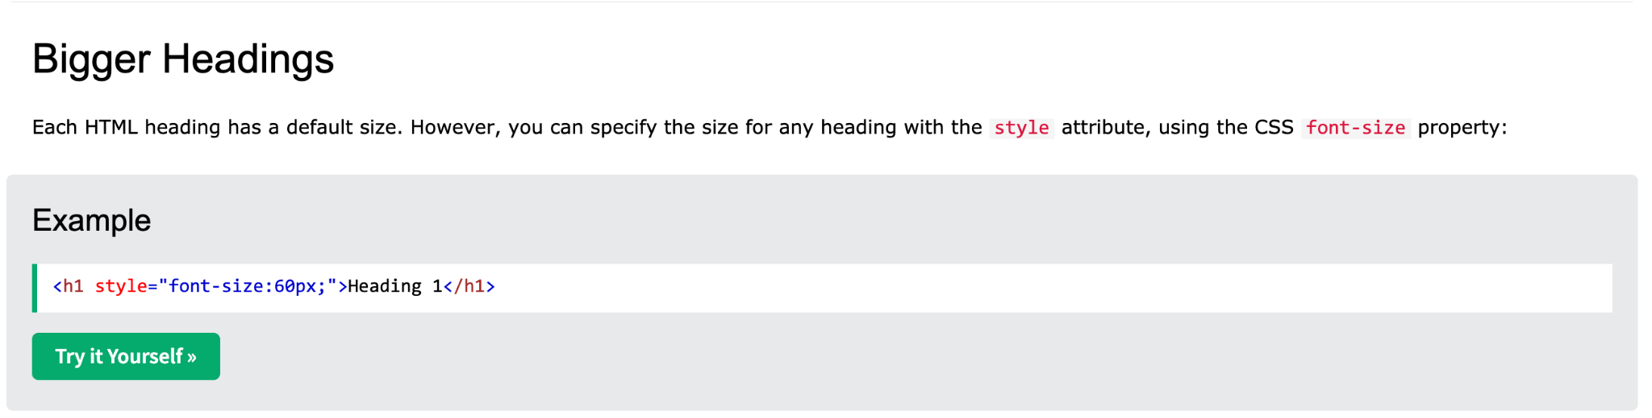
HTML Headings

Slide 29
HTML Paragraphs

Slide 30

HTML Paragraphs

Slide 31
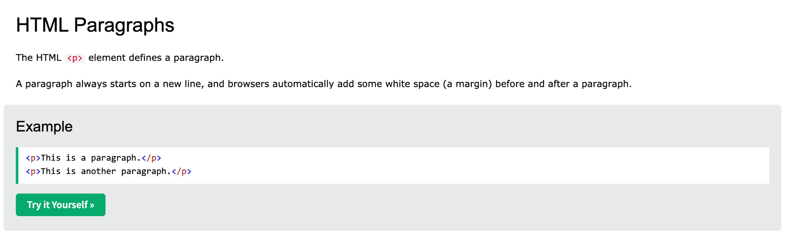
HTML Paragraphs

Slide 32
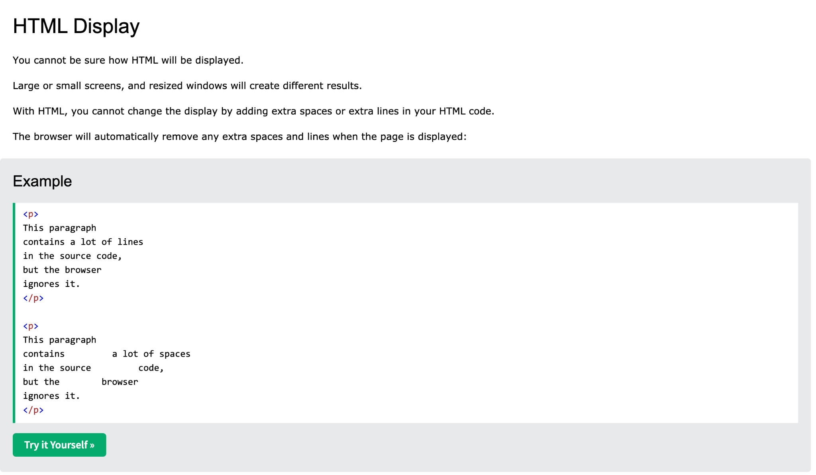
HTML Paragraphs

Slide 33
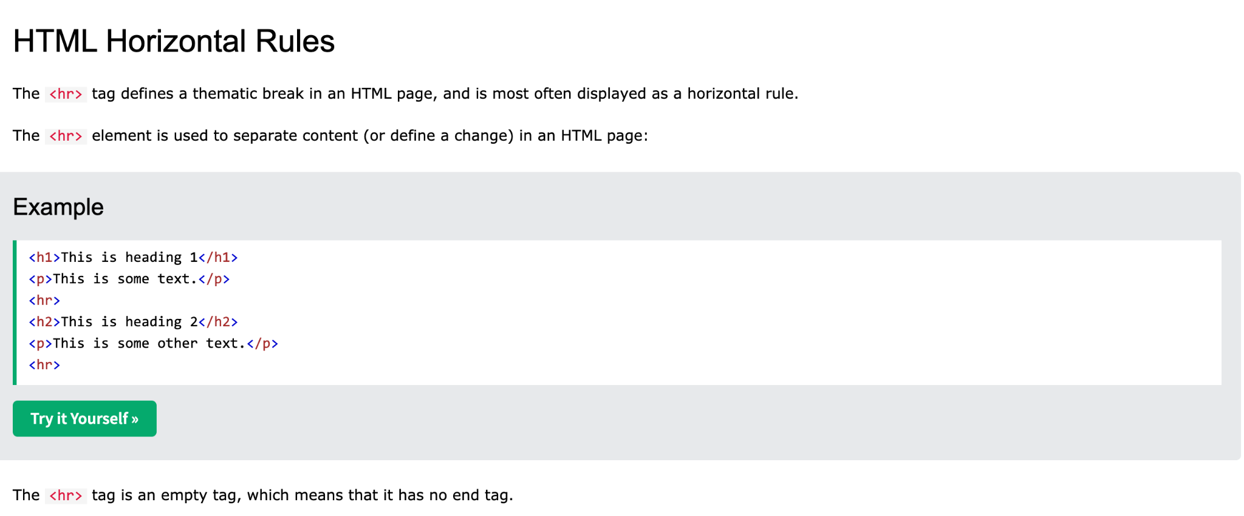
HTML Paragraphs

Slide 34
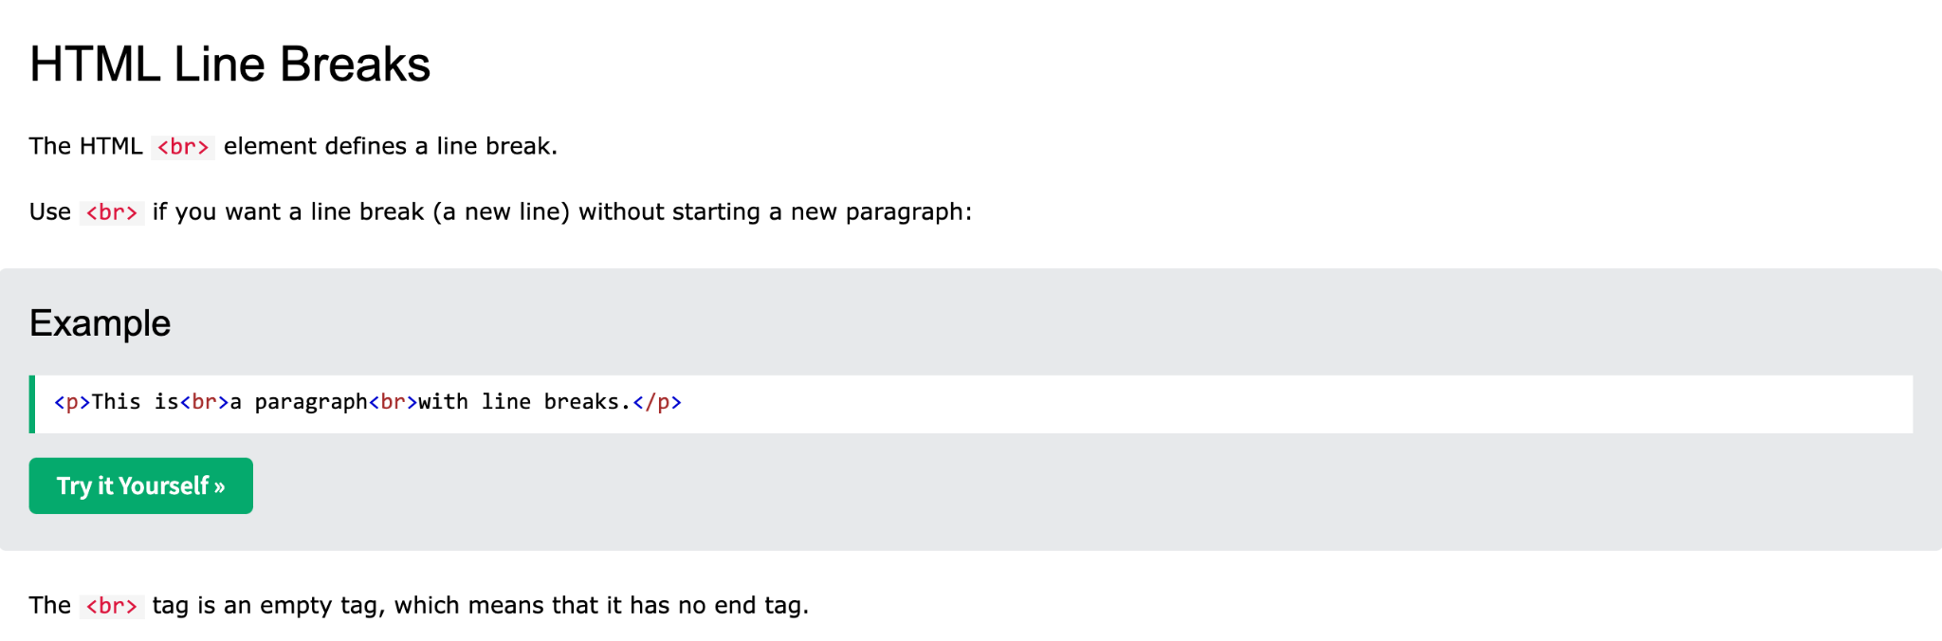
HTML Paragraphs

Slide 35
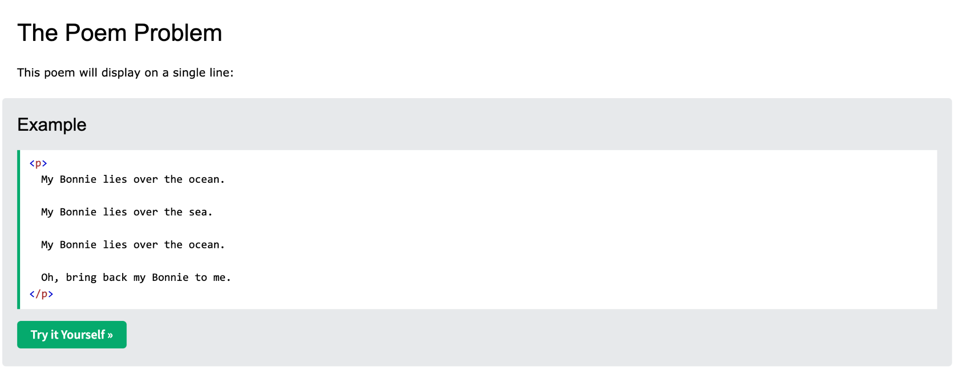
HTML Paragraphs

Slide 36
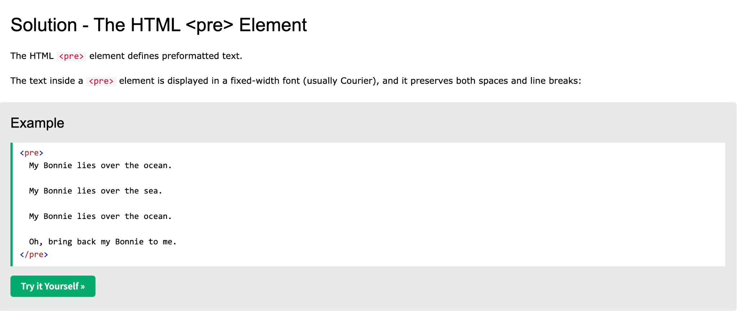
HTML Paragraphs

Slide 37
HTML Styles

Slide 38

HTML Styles

Slide 39

HTML Styles

Slide 40
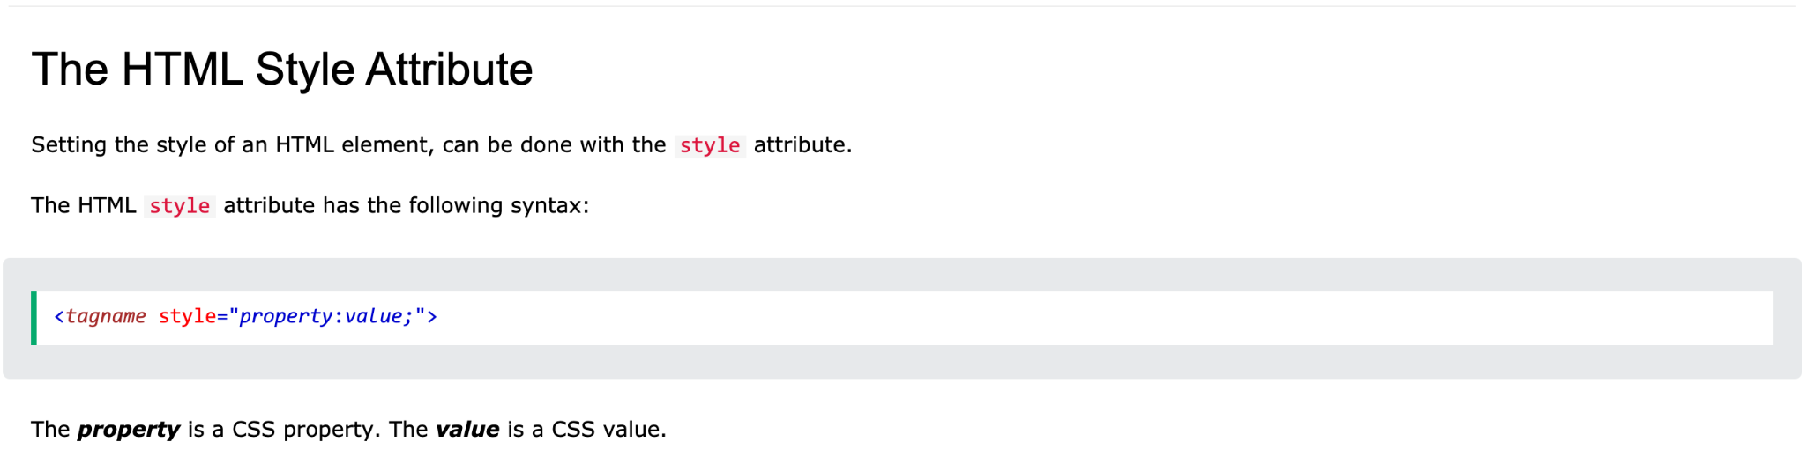
HTML Styles

Slide 41
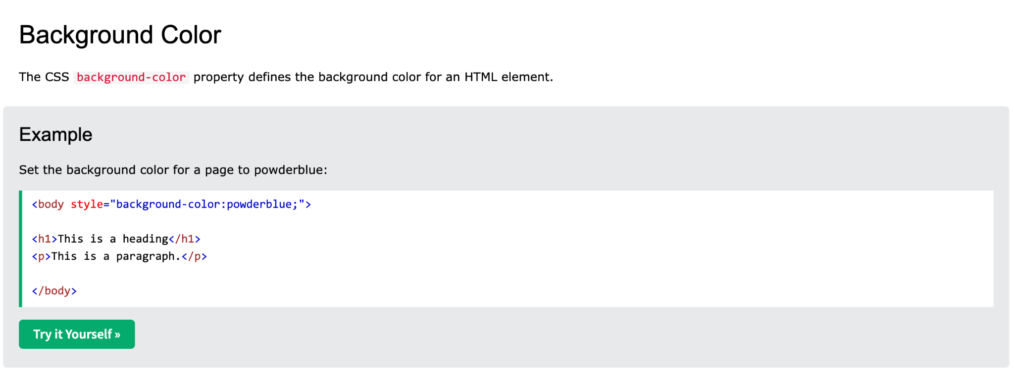
HTML Styles

Slide 42
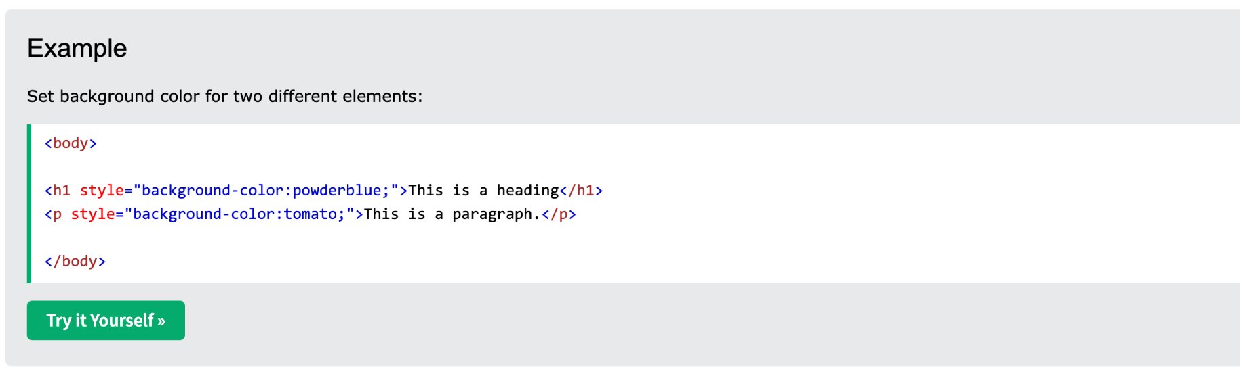
HTML Styles

Slide 43
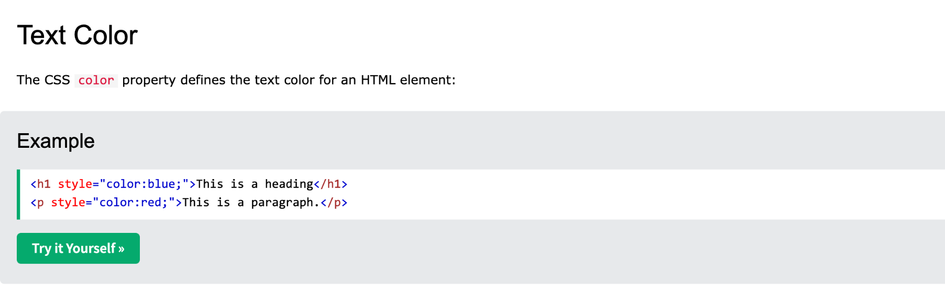
HTML Styles

Slide 44
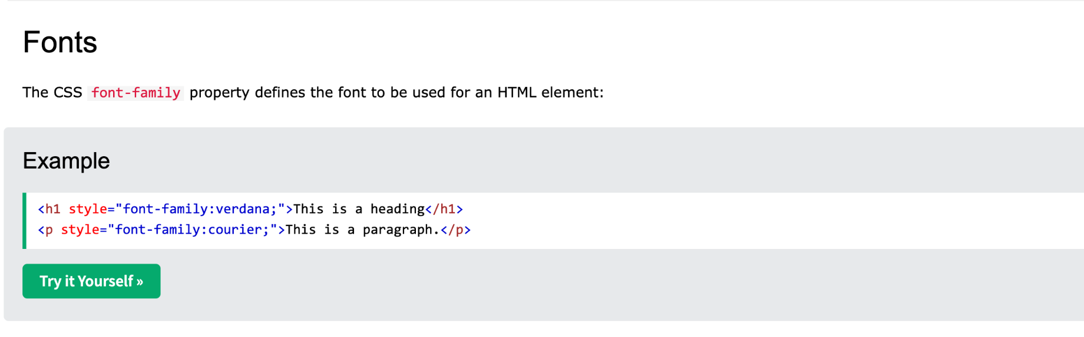
HTML Styles

Slide 45
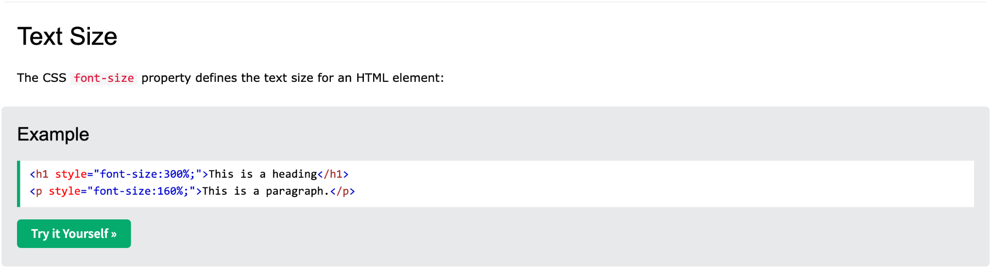
HTML Styles

Slide 46
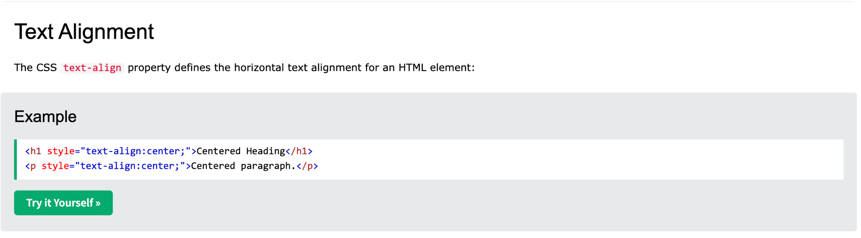
HTML Styles

Slide 47
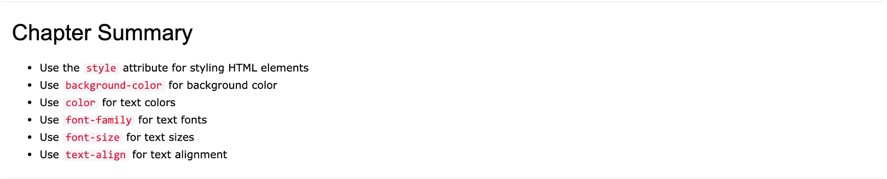
HTML Styles

Slide 48
HTML Text Formatting

Slide 49
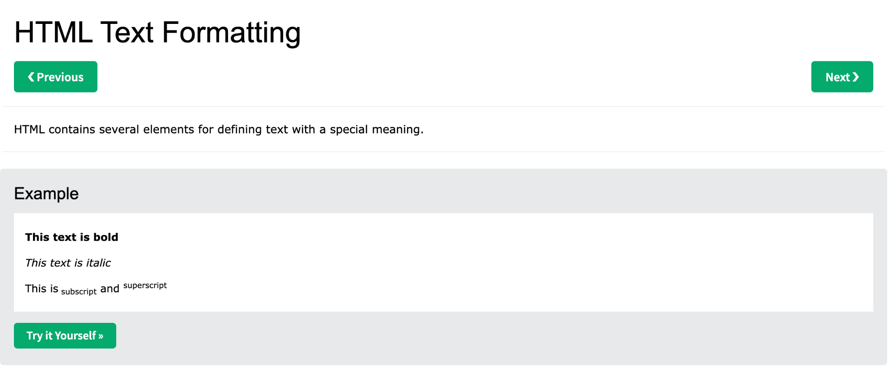
HTML Text Formatting

Slide 50
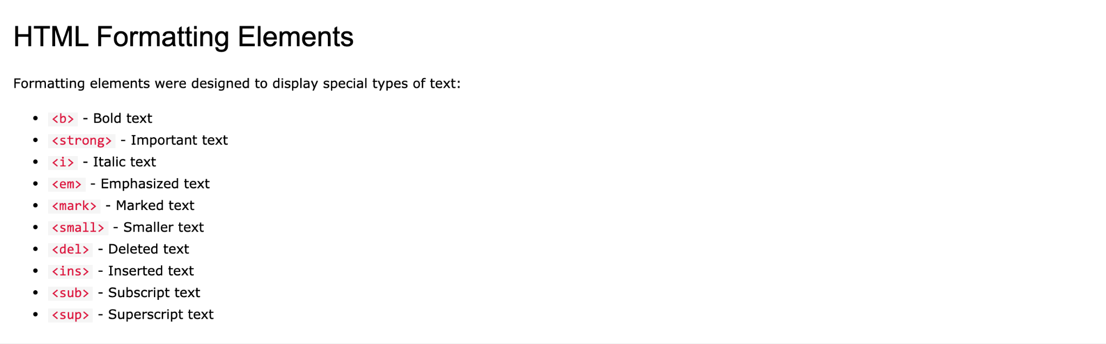
HTML Text Formatting

Slide 51
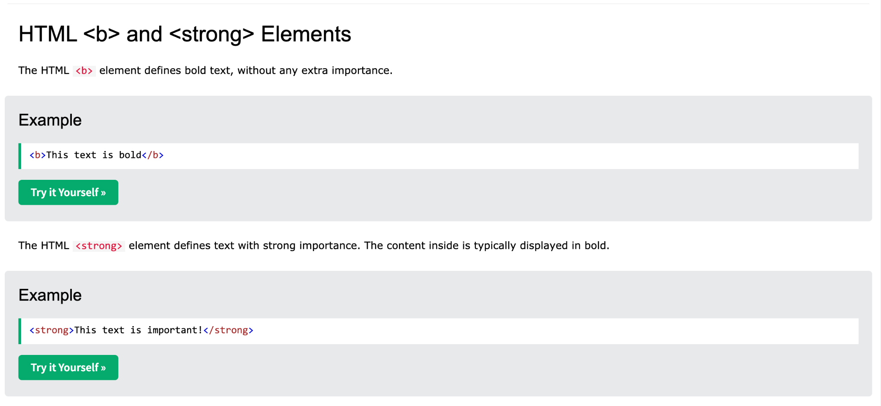
HTML Text Formatting

Slide 52
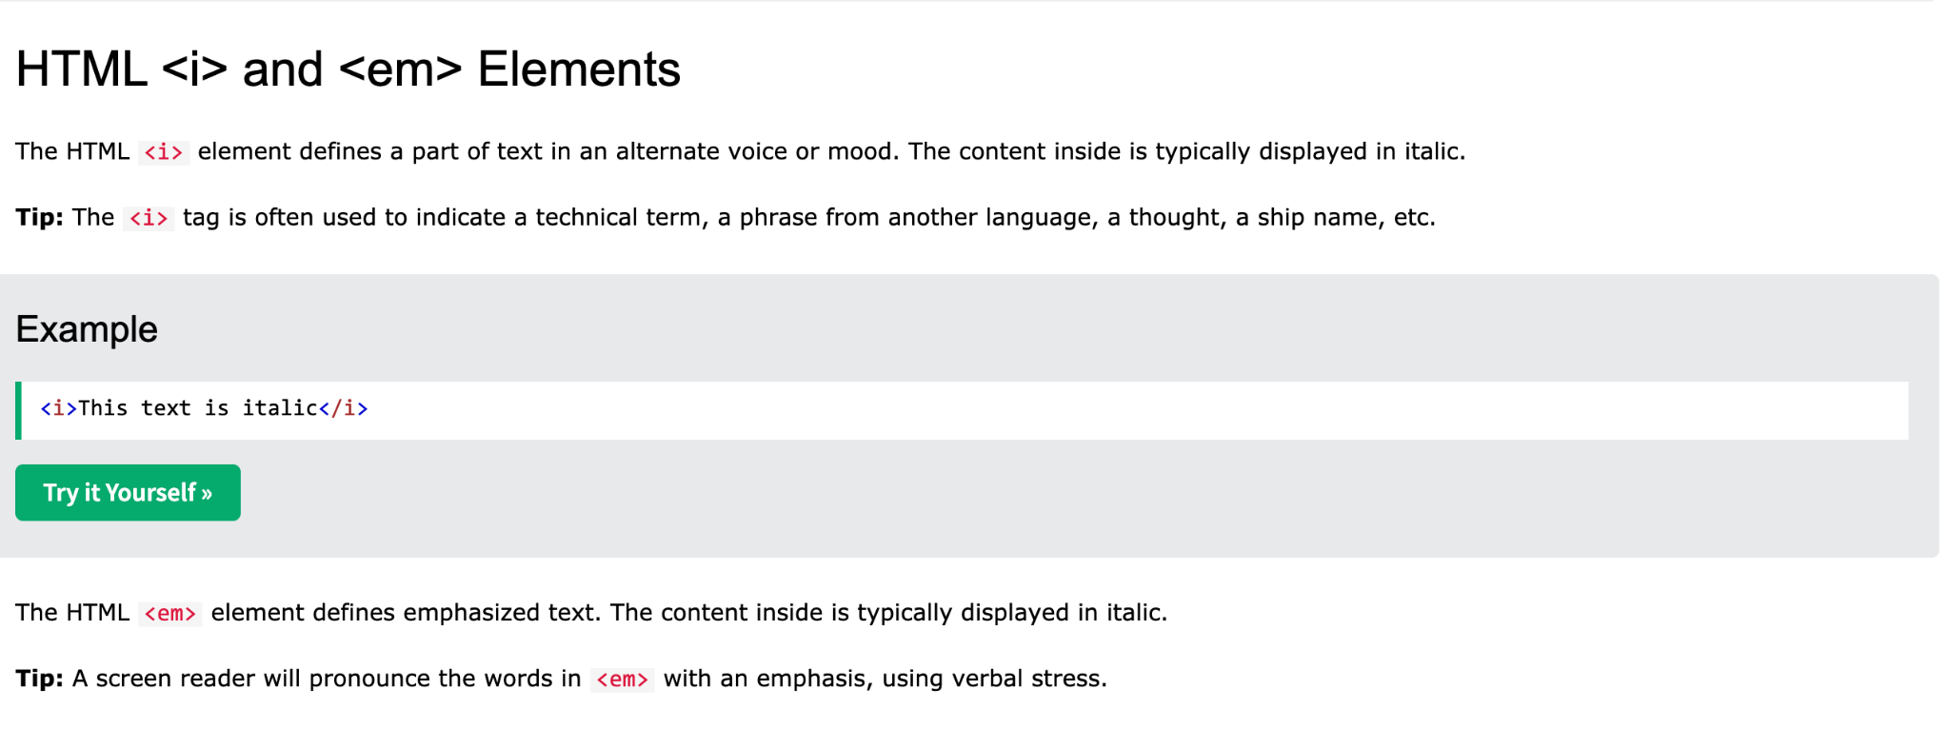
HTML Text Formatting

Slide 53
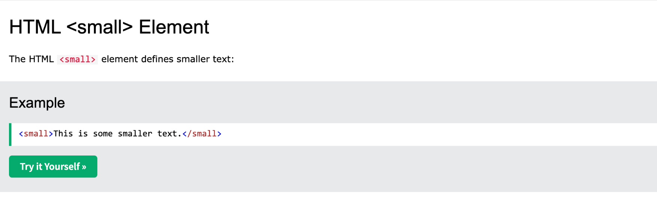
HTML Text Formatting

Slide 54
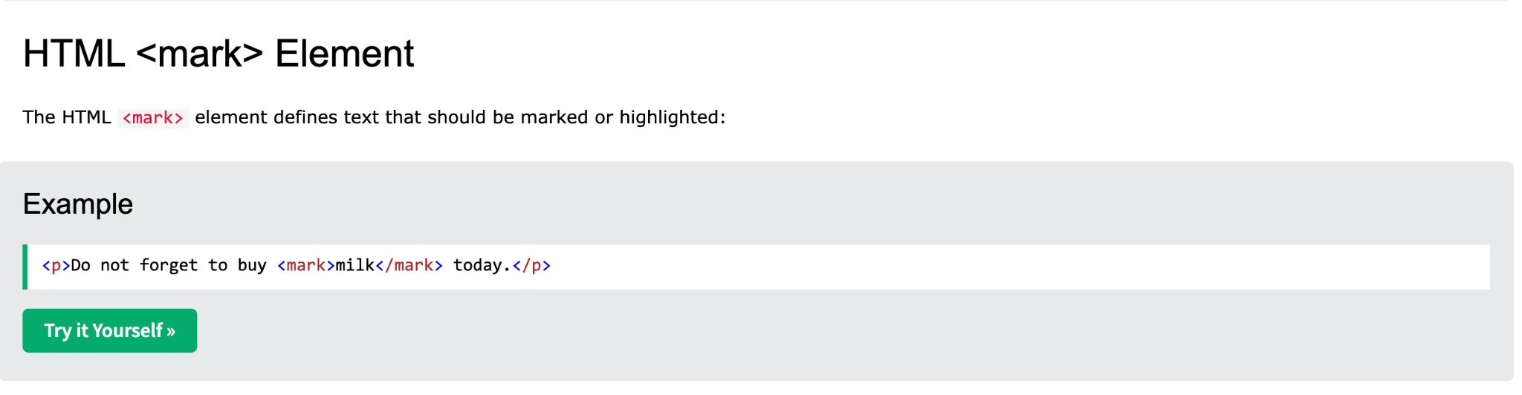
HTML Text Formatting

Slide 55
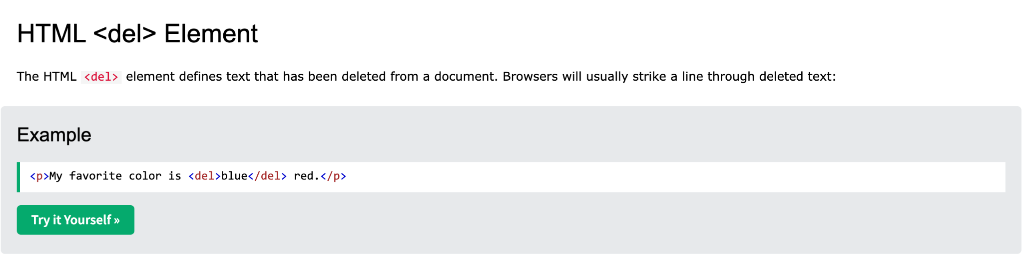
HTML Text Formatting

Slide 56
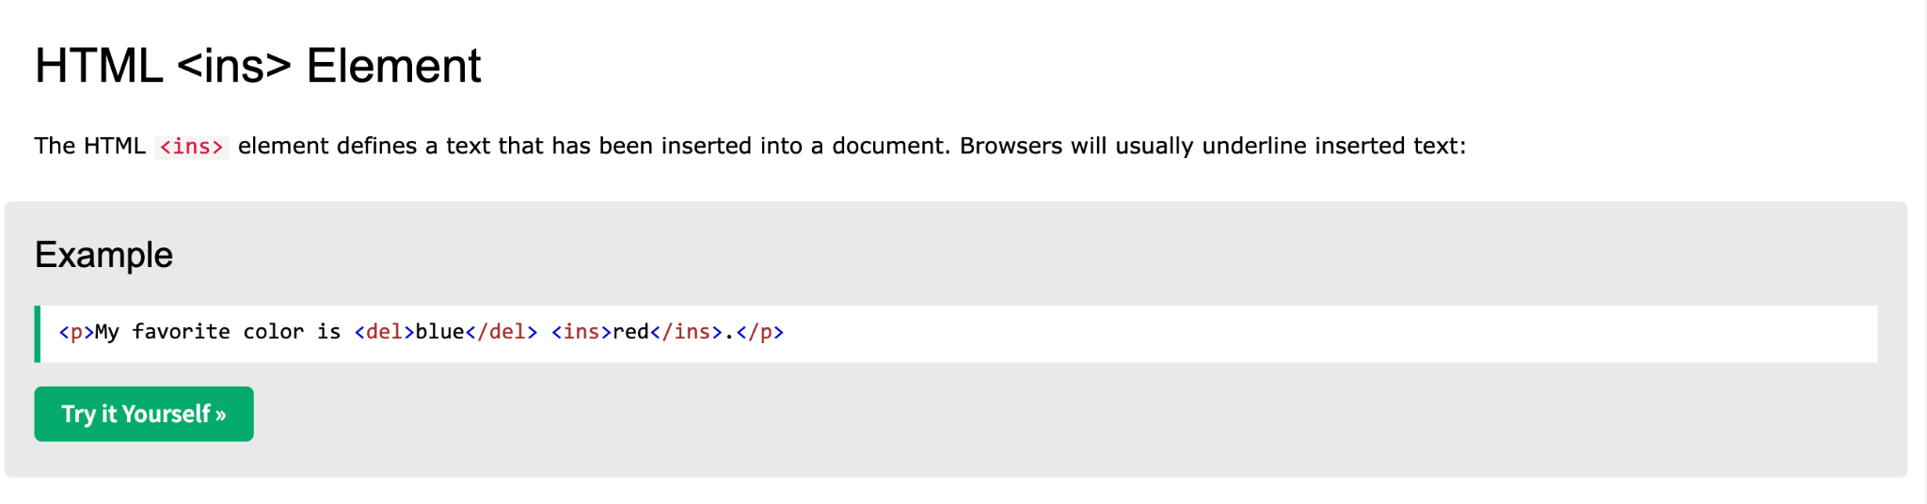
HTML Text Formatting

Slide 57
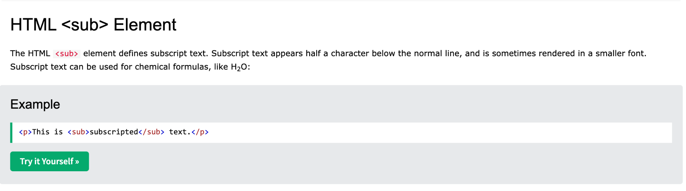
HTML Text Formatting

Slide 58
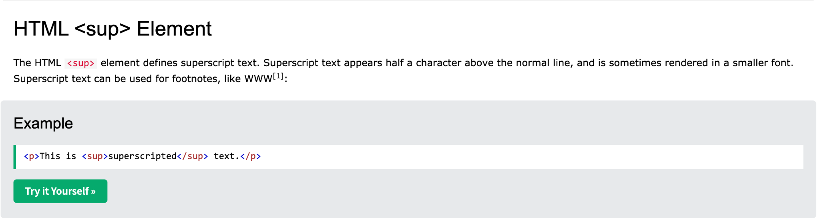
HTML Text Formatting

Slide 59
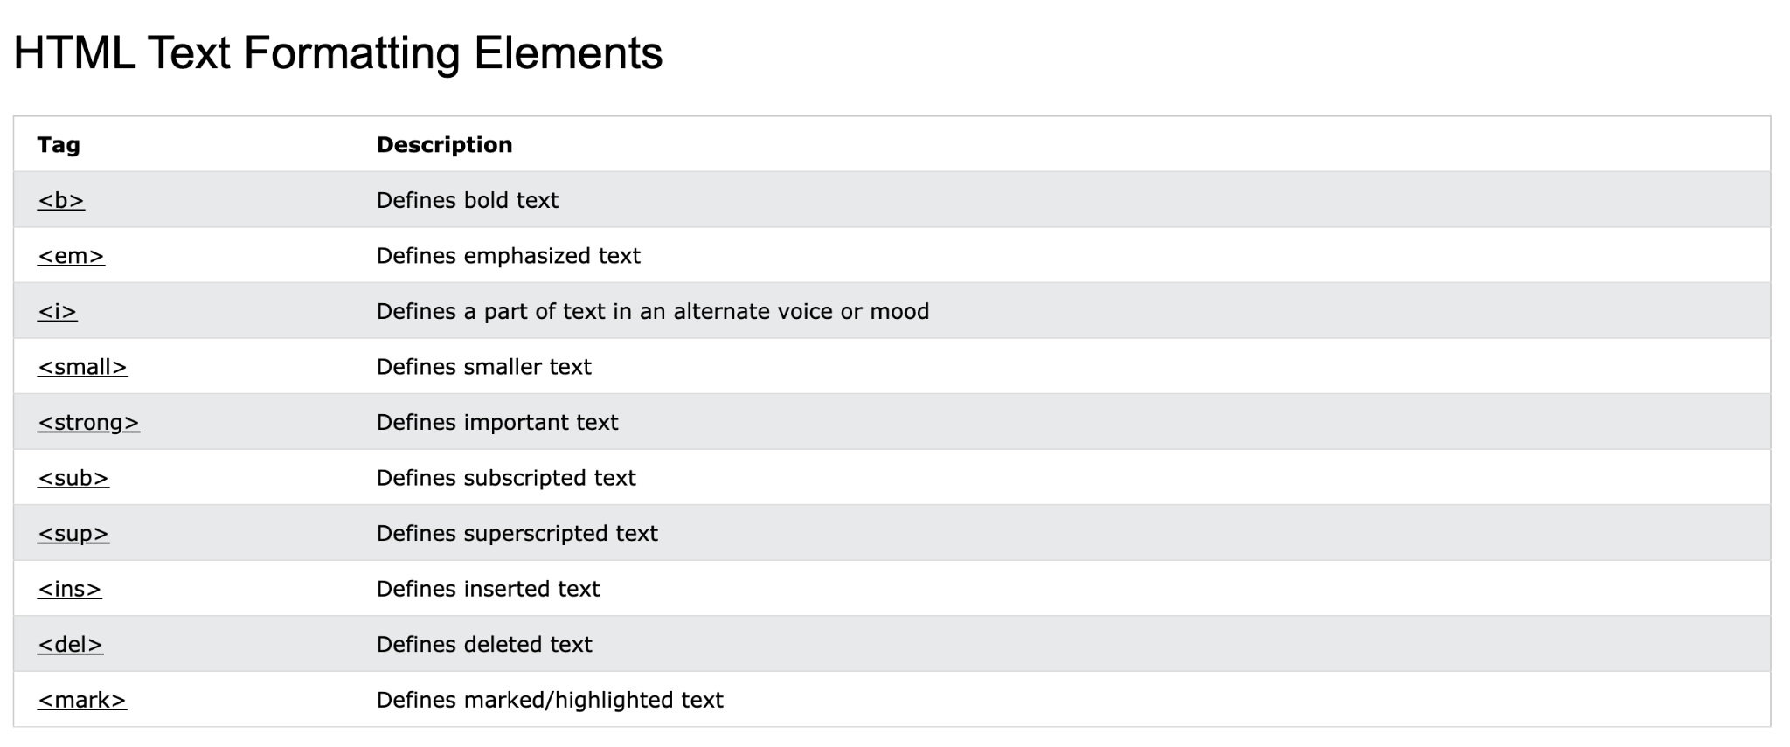
HTML Text Formatting

Slide 60
HTML Comments

Slide 61
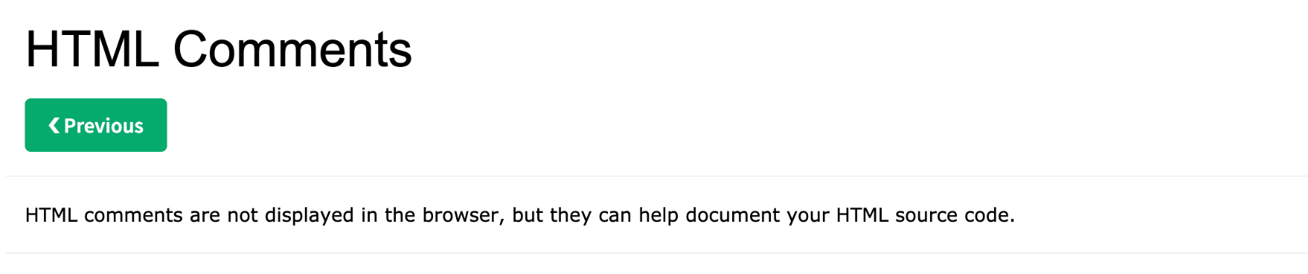
HTML Comments

Slide 62
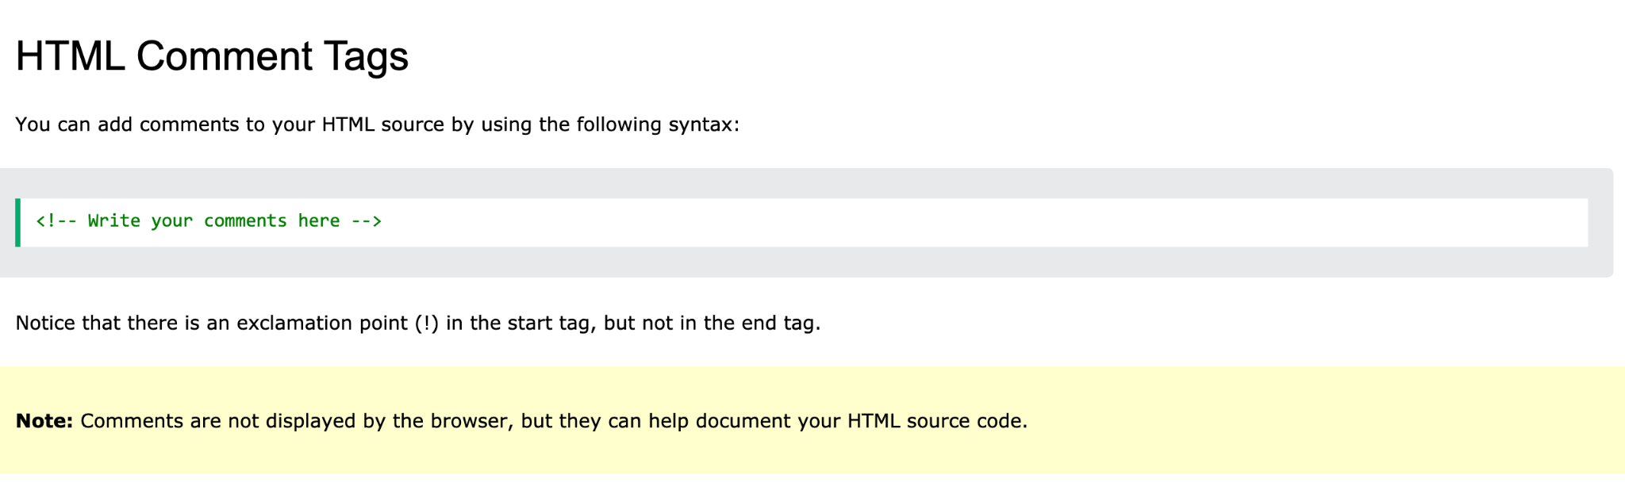
HTML Comments

Slide 63

HTML Comments

Slide 64

HTML Comments

Slide 65
HTML Colors

Slide 66

HTML Colors

Slide 67

HTML Colors

Slide 68

HTML Colors

Slide 69

HTML Colors

Slide 70

HTML Colors

Slide 71

HTML Colors

Slide 72

HTML Colors

Slide 73

HTML Colors

Slide 74
HTML Styles - CSS

Slide 75

HTML Styles - CSS

Slide 76

HTML Styles - CSS

Slide 77

HTML Styles - CSS

Slide 78

HTML Styles - CSS

Slide 79

HTML Styles - CSS

Slide 80

HTML Styles - CSS

Slide 81

HTML Styles - CSS

Slide 82

HTML Styles - CSS

Slide 83

HTML Styles - CSS

Slide 84

HTML Styles - CSS

Slide 85

HTML Styles - CSS

Slide 86

HTML Styles - CSS

Slide 87
HTML Links

Slide 88

HTML Links

Slide 89

HTML Links

Slide 90

HTML Links

Slide 91

HTML Links

Slide 92

HTML Links

Slide 93

HTML Links

Slide 94

HTML Links

Slide 95

HTML Links

Slide 96

HTML Links

Slide 97

HTML Links

Slide 98

HTML Links

Slide 99
HTML Images

Slide 100

HTML Images

Slide 101

HTML Images

Slide 102

HTML Images

Slide 103

HTML Images

Slide 104

HTML Images

Slide 105

HTML Images

Slide 106

HTML Images

Slide 107

HTML Images

Slide 108

HTML Images

Slide 109

HTML Images

Slide 110

HTML Images

Slide 111

HTML Images

Slide 112

HTML Images

Slide 113

HTML Images

Slide 114

HTML Images

Slide 115
HTML Tables

Slide 116

HTML Tables

Slide 117

HTML Tables

Slide 118

HTML Tables

Slide 119

HTML Tables

Slide 120

HTML Tables

Slide 121

HTML Tables

Slide 122

HTML Tables

Slide 123

HTML Tables

Slide 124

HTML Tables

Slide 125
HTML Table Borders

Slide 126

HTML Table Borders

Slide 127

HTML Table Borders

Slide 128

HTML Table Borders

Slide 129

HTML Table Borders

Slide 130

HTML Table Borders

Slide 131

HTML Table Borders

Slide 132
HTML Table Sizes

Slide 133

HTML Table Sizes

Slide 134

HTML Table Sizes

Slide 135

HTML Table Sizes

Slide 136

HTML Table Sizes

Slide 137
HTML Table Headers

Slide 138

HTML Table Headers

Slide 139

HTML Table Headers

Slide 140

HTML Table Headers

Slide 141

HTML Table Headers

Slide 142

HTML Table Headers

Slide 143

HTML Table Headers

Slide 144

HTML Table Headers

Slide 145

HTML Table Headers

Slide 146
HTML Table Headers

Slide 147
HTML Table Padding & Spacing

Slide 148

HTML Table Padding & Spacing

Slide 149

HTML Table Padding & Spacing

Slide 150

HTML Table Padding & Spacing

Slide 151

HTML Table Padding & Spacing

Slide 152
HTML Table Colspan & Rowspan

Slide 153

HTML Table Colspan & Rowspan

Slide 154

HTML Table Colspan & Rowspan

Slide 155

HTML Table Colspan & Rowspan

Slide 156
HTML Lists

Slide 157

HTML Lists

Slide 158

HTML Lists

Slide 159

HTML Lists

Slide 160

HTML Lists

Slide 161
HTML Unordered Lists

Slide 162

HTML Unordered Lists

Slide 163

HTML Unordered Lists

Slide 164

HTML Unordered Lists

Slide 165

HTML Unordered Lists

Slide 166

HTML Unordered Lists

Slide 167

HTML Unordered Lists

Slide 168

HTML Unordered Lists

Slide 169

HTML Unordered Lists

Slide 170
HTML Ordered Lists

Slide 171

HTML Ordered Lists

Slide 172

HTML Ordered Lists

Slide 173

HTML Ordered Lists

Slide 174

HTML Ordered Lists

Slide 175

HTML Ordered Lists

Slide 176

HTML Ordered Lists

Slide 177

HTML Ordered Lists

Slide 178

HTML Ordered Lists

Slide 179

HTML Ordered Lists

Slide 180

HTML Ordered Lists

